Slide 1
HackNSUT
Detection and Prediction of lifestyle diseases
Team Name : WreckTrek
Theme : HealthCare
Team : Anurag Gandhi
Dheeraj Khanna
Naman Goyal
Siddharth Bedi

Slide 2
Why an application for Lifestyle Diseases?
Though not completely but these diseases can be highly linked with the day to day activities of an individual.
Early and fast detection and/or prediction of potential lifestyle disease can hugely reduce the risk of chronic disease.
Instant and accurate results without the need of visiting a professional.

Slide 3
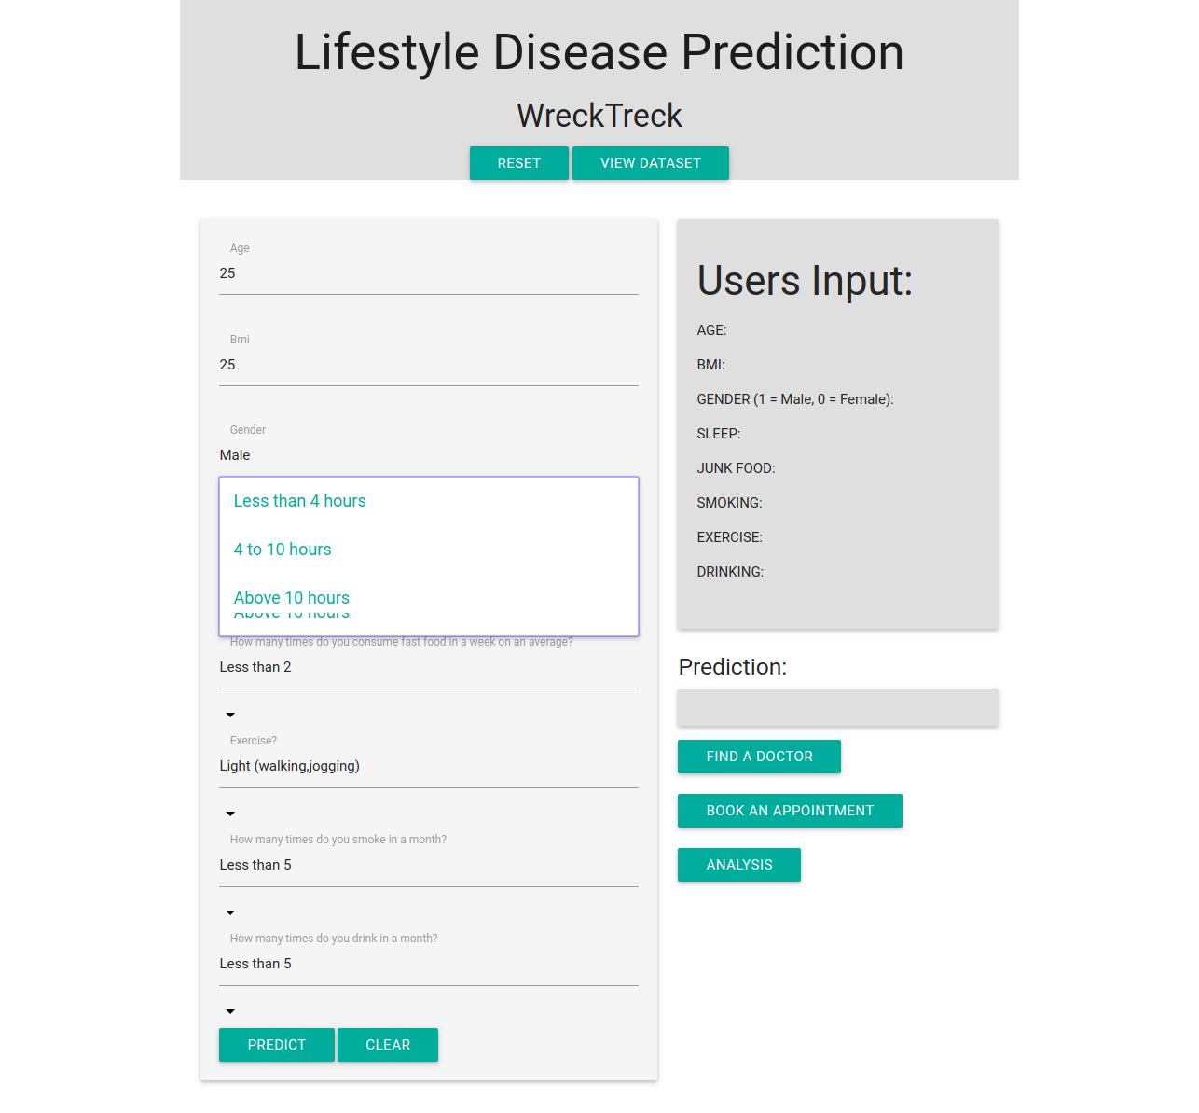
Page 1 : Web Application Questionnaire

Slide 4
How does it work?
The user has to provide the most suitable response to the given questionnaire.
The data is then saved and fed to the Machine Learning algorithm in the backend.
The process is then executed and the output is fed back to the user.
The process is then executed and the output is fed back to the user.

Slide 5
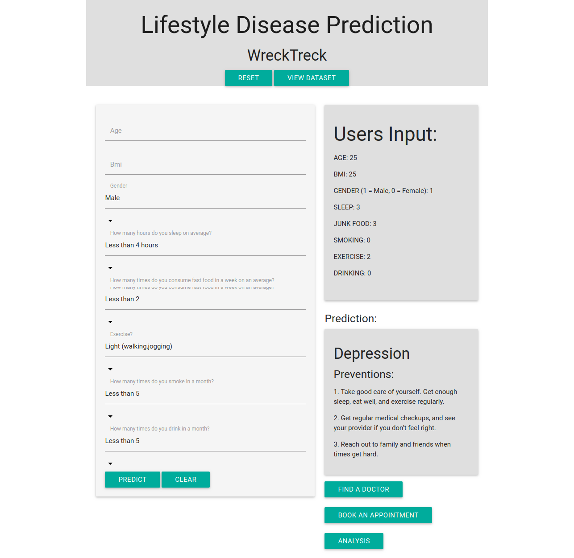
Page 2 : Disease Prediction and Detection

Slide 6
KEY FEATURES
A reliable and accurate dataset created with the help of trusted data sources.
Unique approach and algorithm used.
A simple yet detailed easy to understand user interface.
Preventive measures and high risk alert provided..
Attractive visual representation.

Slide 7
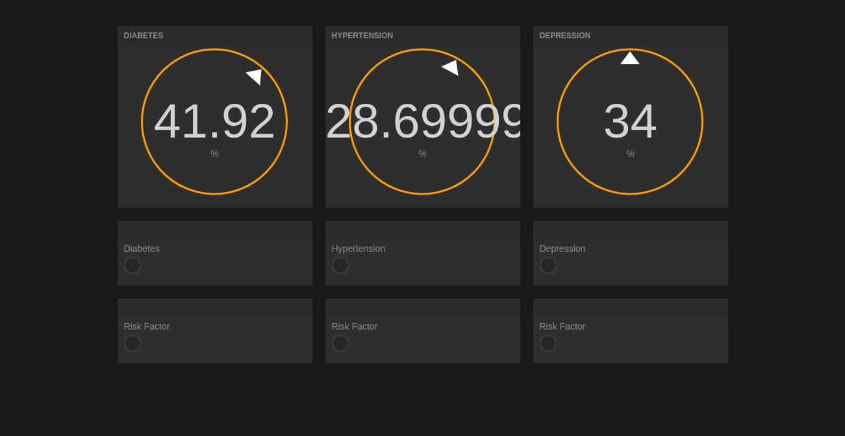
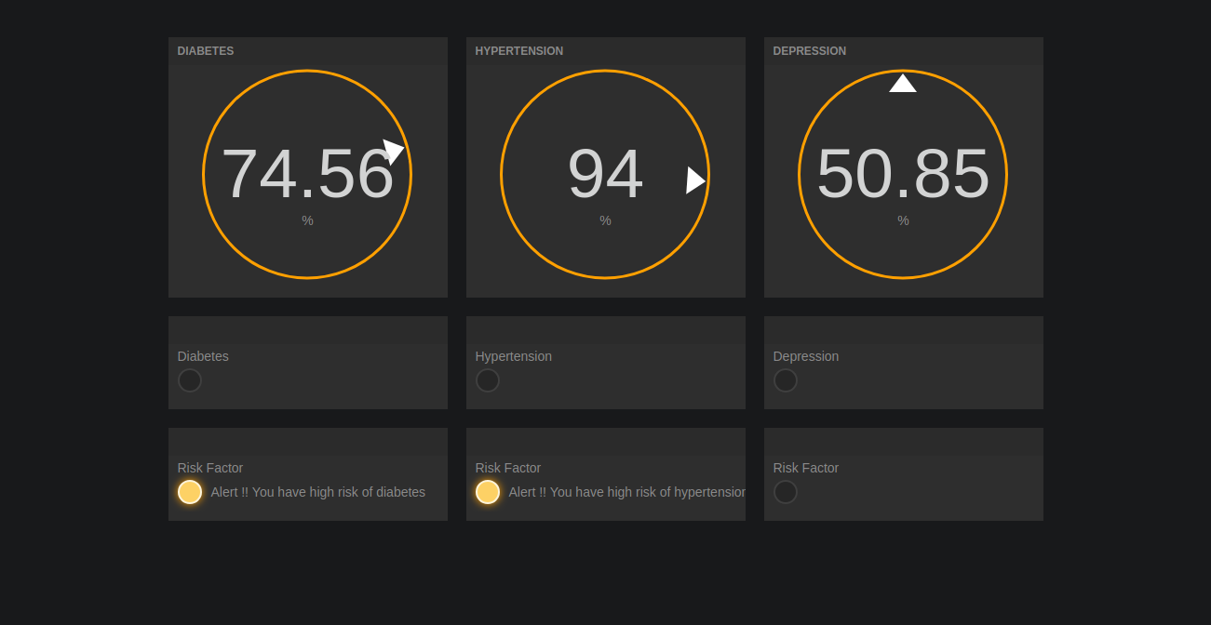
Page 3 : Detailed analysis of detected disease

Slide 8
Future Development
System works for three major disease currently but can easily be extended easily.
Database size and hence accuracy increase with increase in use .
Adaptive Application
Can be incorporated by corporates, Government and common Citizens at various level of operations.
Chat-bot system can be incorporated.
Medical prescription service can be incorporated to provide better services.

